Slide 1
PROBLEM STATEMENT
Manually assessing records is time-consuming and prone to bias. A data-driven solution is needed to standardize the promotion decision process based on historical patterns and employee performance metrics which is why a ml model is to be constructed for predicting chances of employees getting promoted
The HR department faces a challenge: identifying employees for promotion efficiently and objectively.

Slide 2
HR Analytics Hackathon
Model Performance Comparison (F1 Score)
Logistic Regression(Tuned with best parameter): F1 = 0.37
Decision Tree(Tuned with best parameter): F1 = 0.42
Random Forest (Tuned with best parameter): F1 =0.47
Ada Boosting = 0.24 - Not giving best result with tuning also
Gradient Boosting (Tuned with best parameter ): F1 = 0.49
Gradient Boosting (Tuned with best parameter and probability threshold ): F1 = 0.51
XGBoost (Tuned + best Threshold): F1 = 0.49
Notebook Link: Ani-123-design/GoogleColabNotebook
Gradient Boosting achieved the highest F1 score among all evaluated models and perfomed well on training and test data without any overfitting
Final GradientBoost model was pickled and deployed via:
FastAPI Link (real-time REST API) - Ani-123-design/Repo_Fast_API_Hackathon
Streamlit UI (interactive web application) -Ani-123-design/hackathon_inceptez_Ds_25
R Anirudh Srinivas

Slide 3
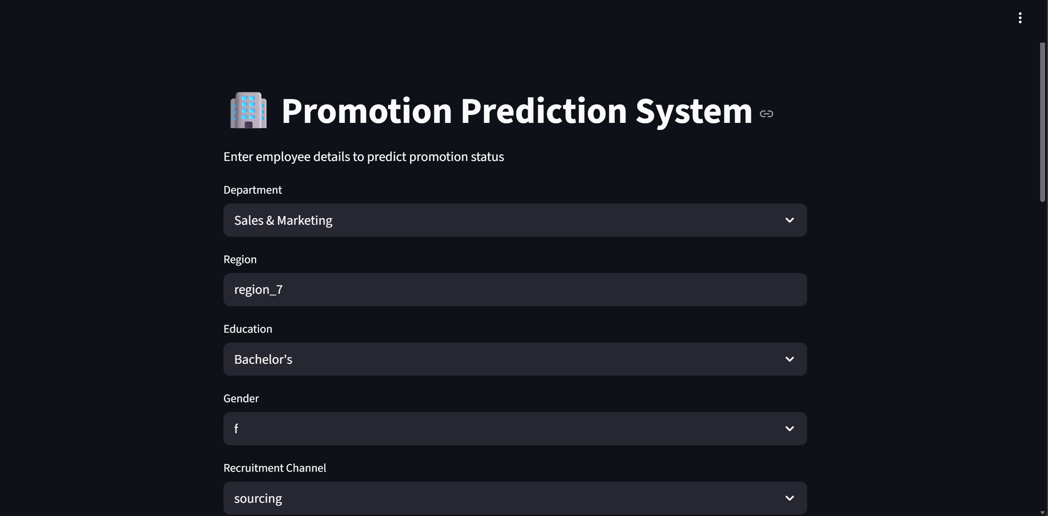
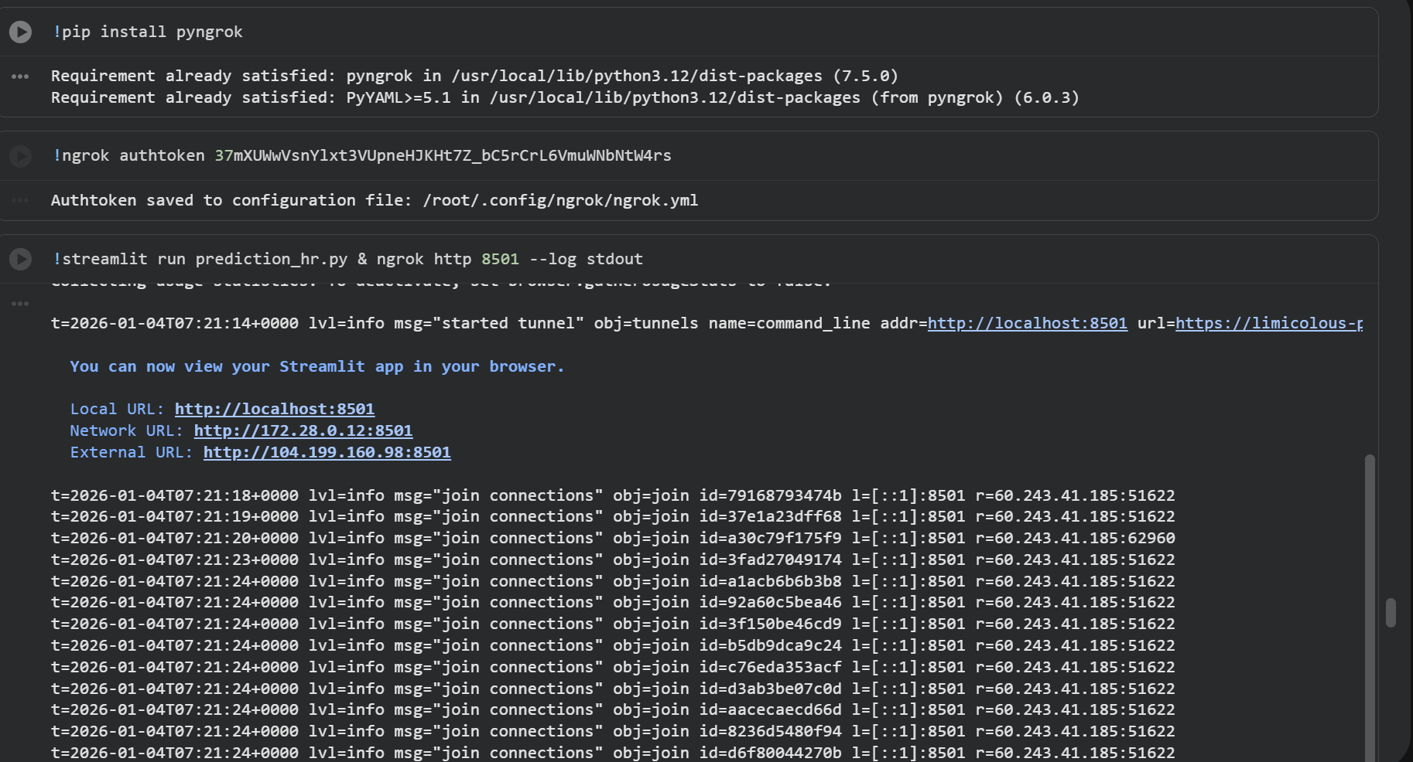
STREAMLIT APP - LOCAL

Slide 4
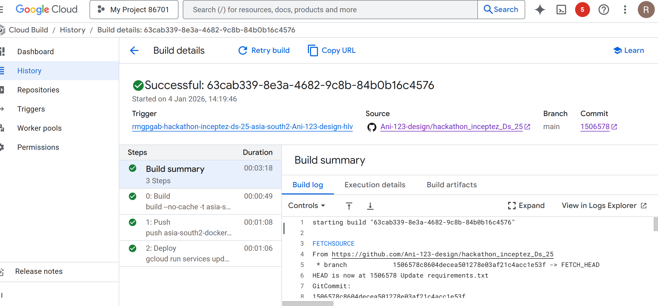
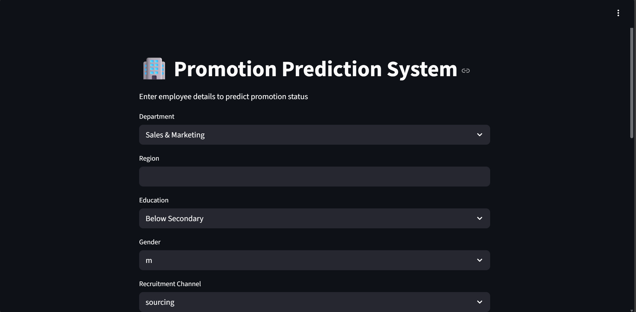
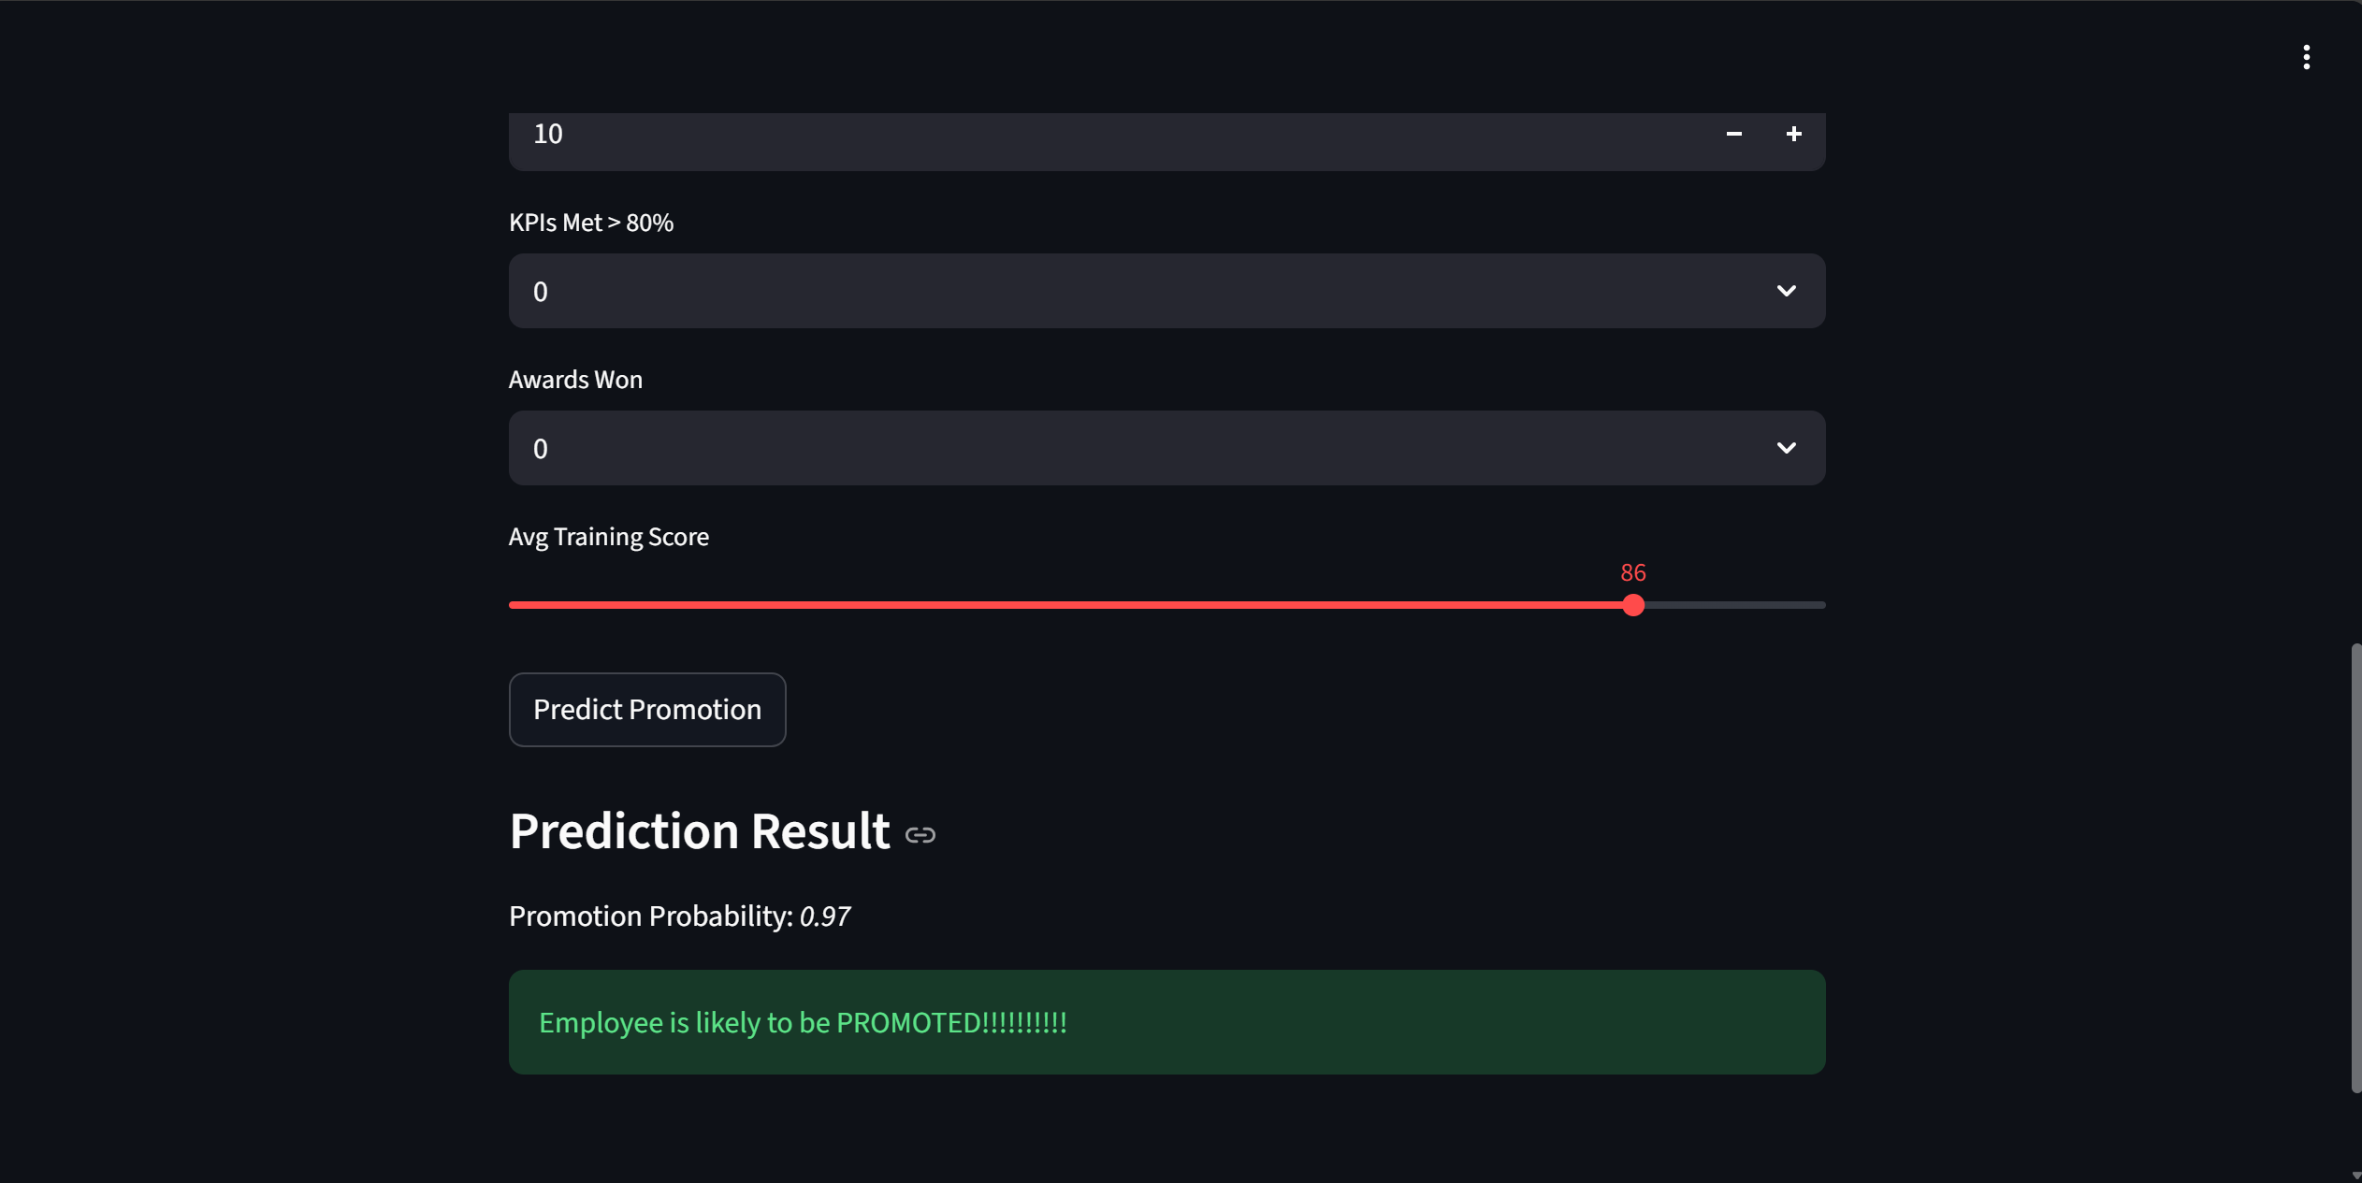
STREAMLIT - GCP

Slide 5
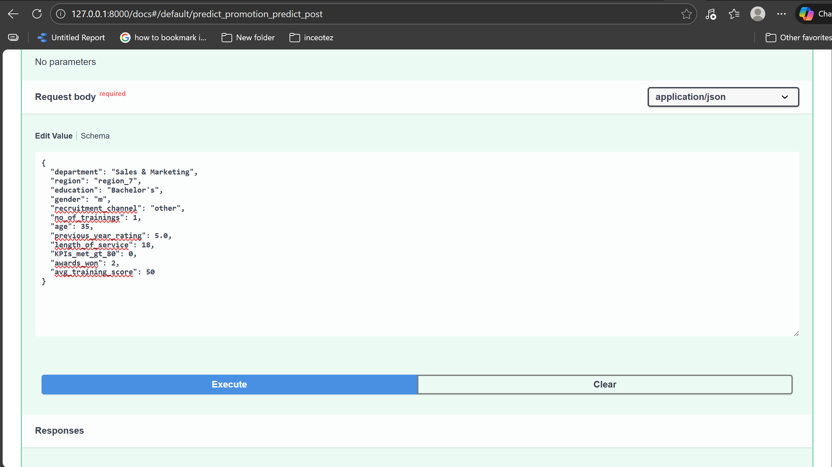
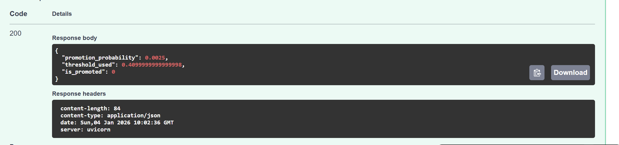
FastAPI - LOCAL

Slide 6
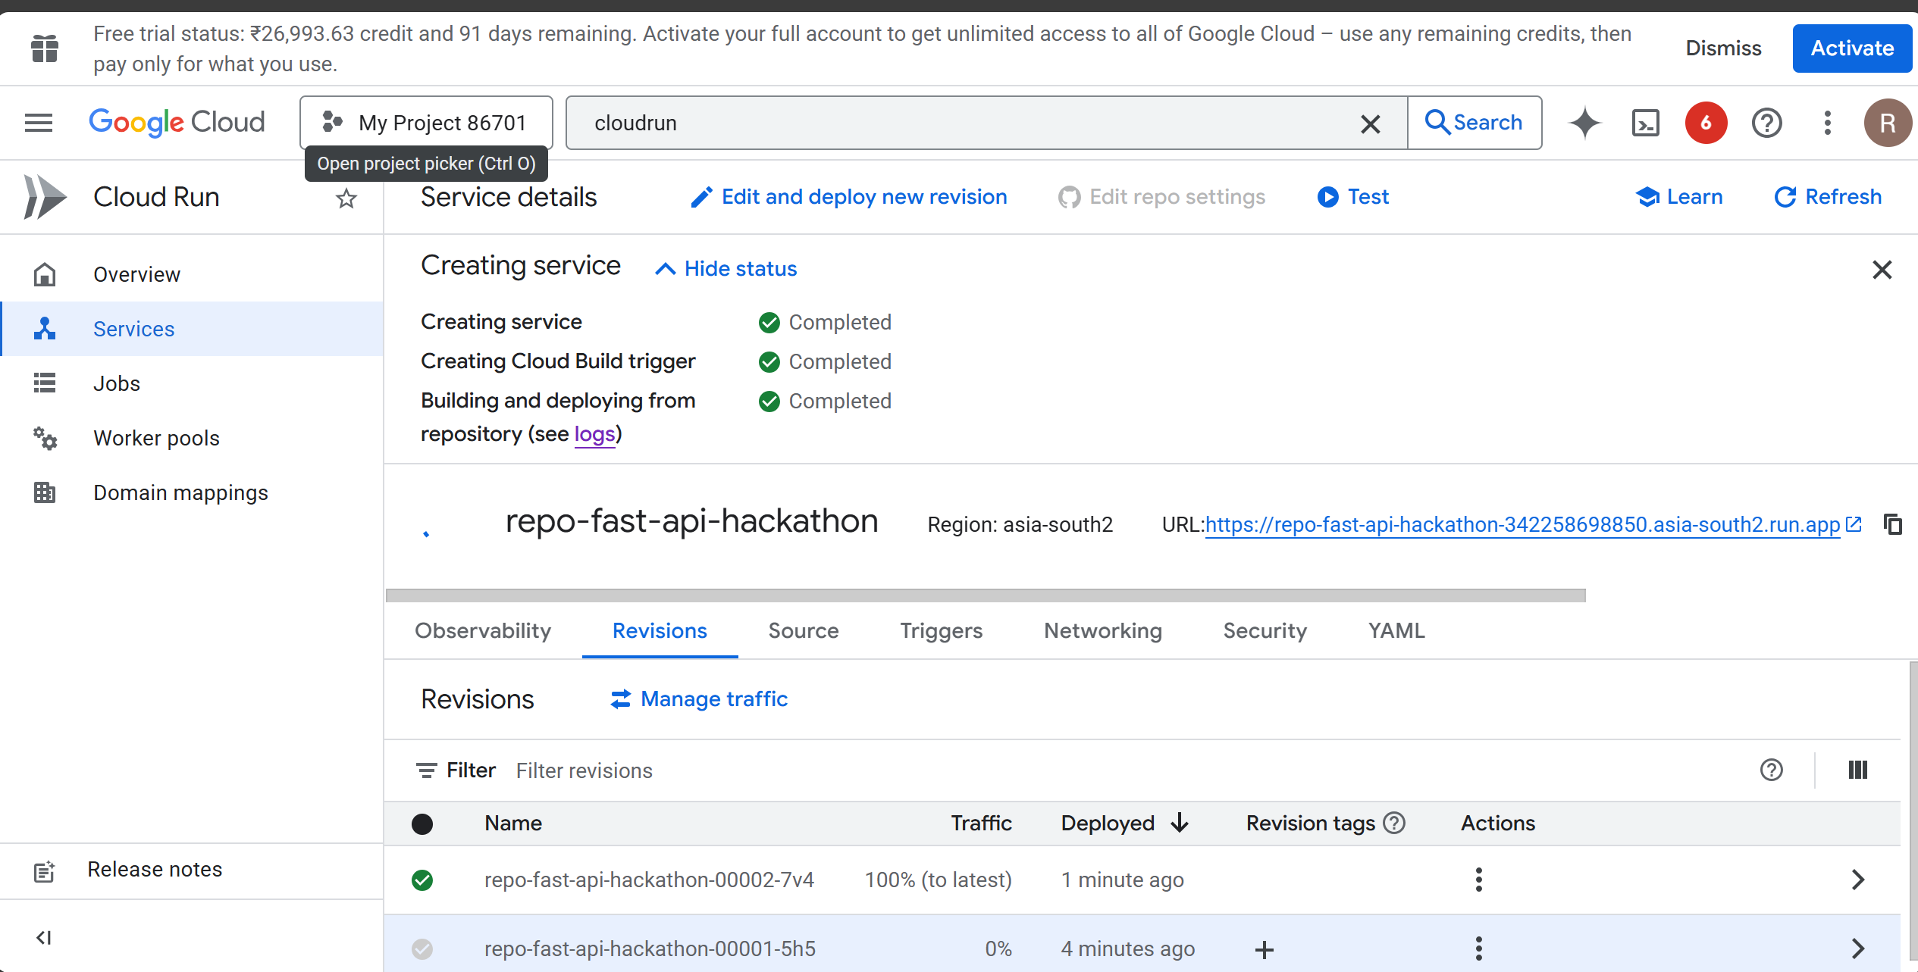
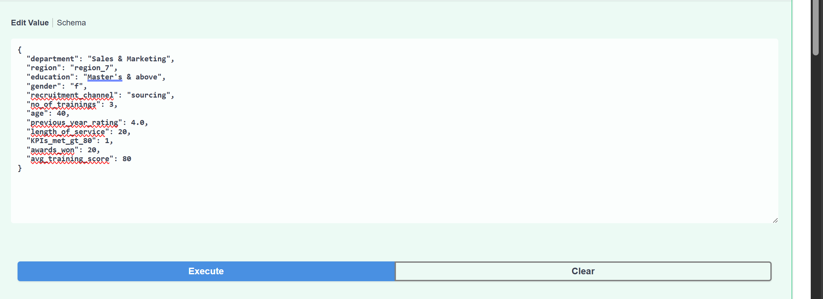
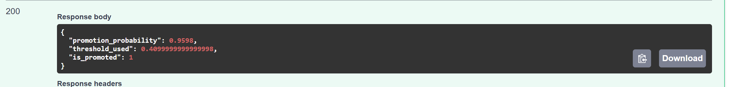
FastAPI - GCP

Slide 7
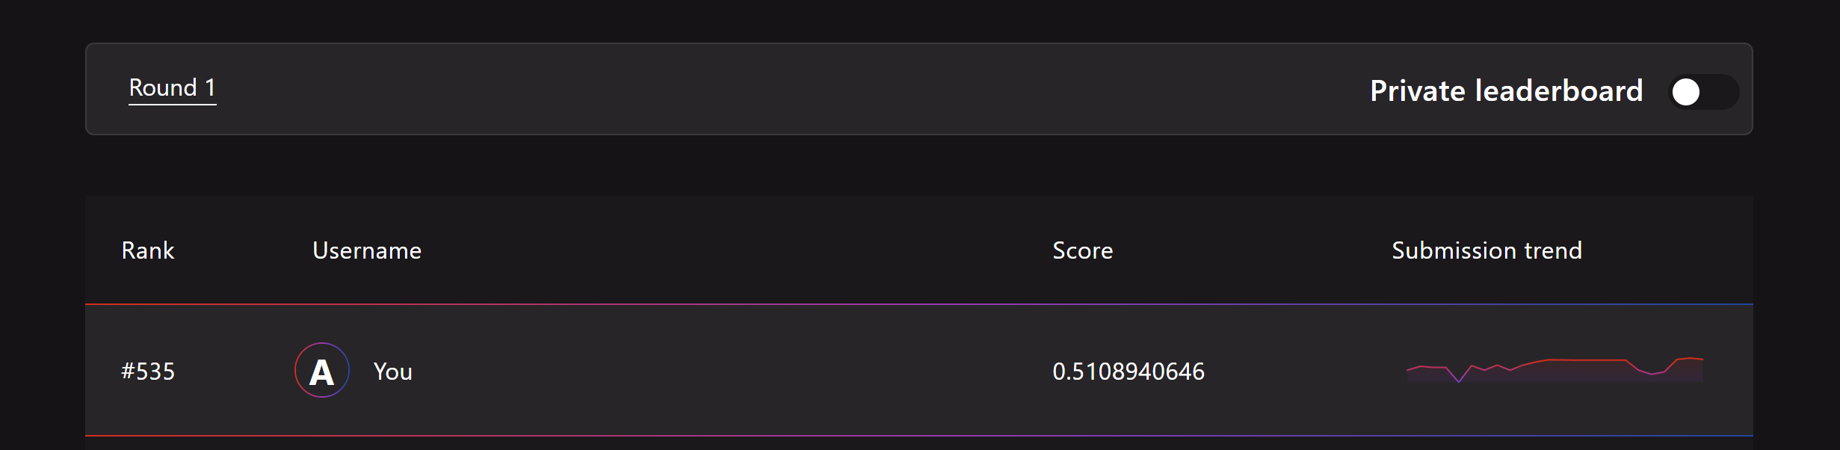
SUBMISSION

Slide 8
Future Scope
Explore additional classification algorithms like SVM
Consider ensemble methods and voting classifier

Slide 9
THANK YOU!!!!!

